Slide 1
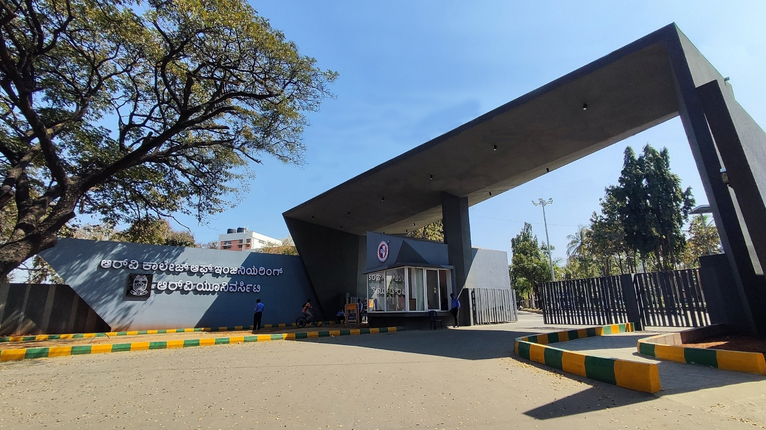
Robotic Arm Assistance in Laparoscopic Surgery
Manufacturing processes & Team No. 39
26 April 2025

Slide 2
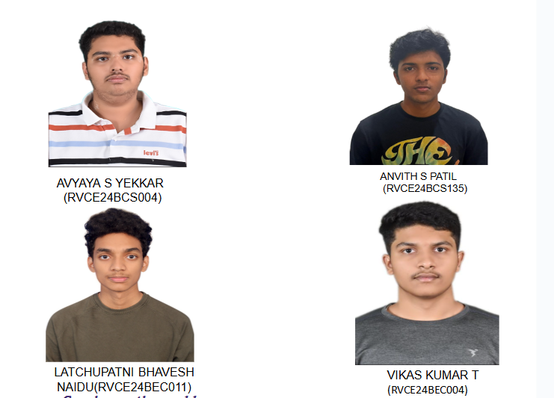




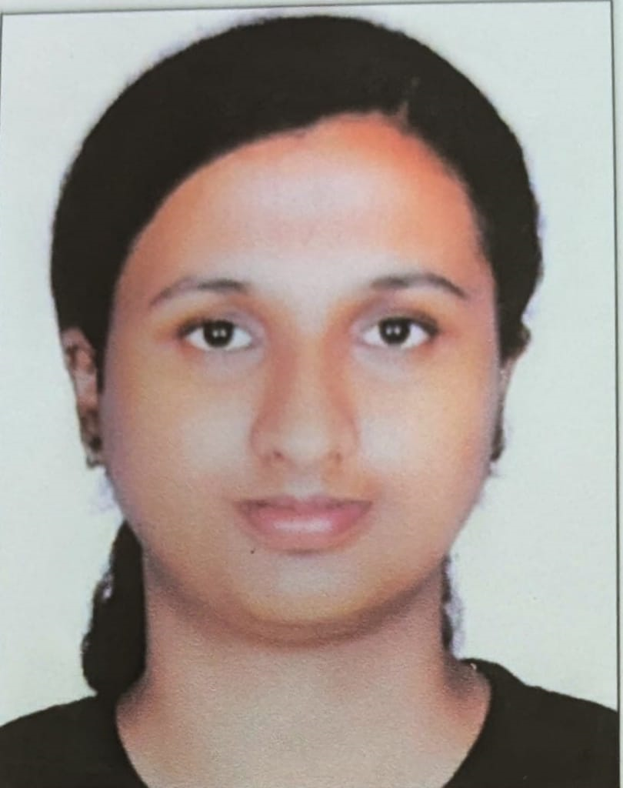
Robotic Arm Assistance in Laparoscopic Surgery
AVYAYA S YEKKAR
ANVITH S PATIL
Prof Manasa M
Assistant Professor
AIML
LATCHUPATNI BHAVESH
NAIDU
VIKAS KUMAR T
26 April 2025
Notes:
‹#›

Slide 3
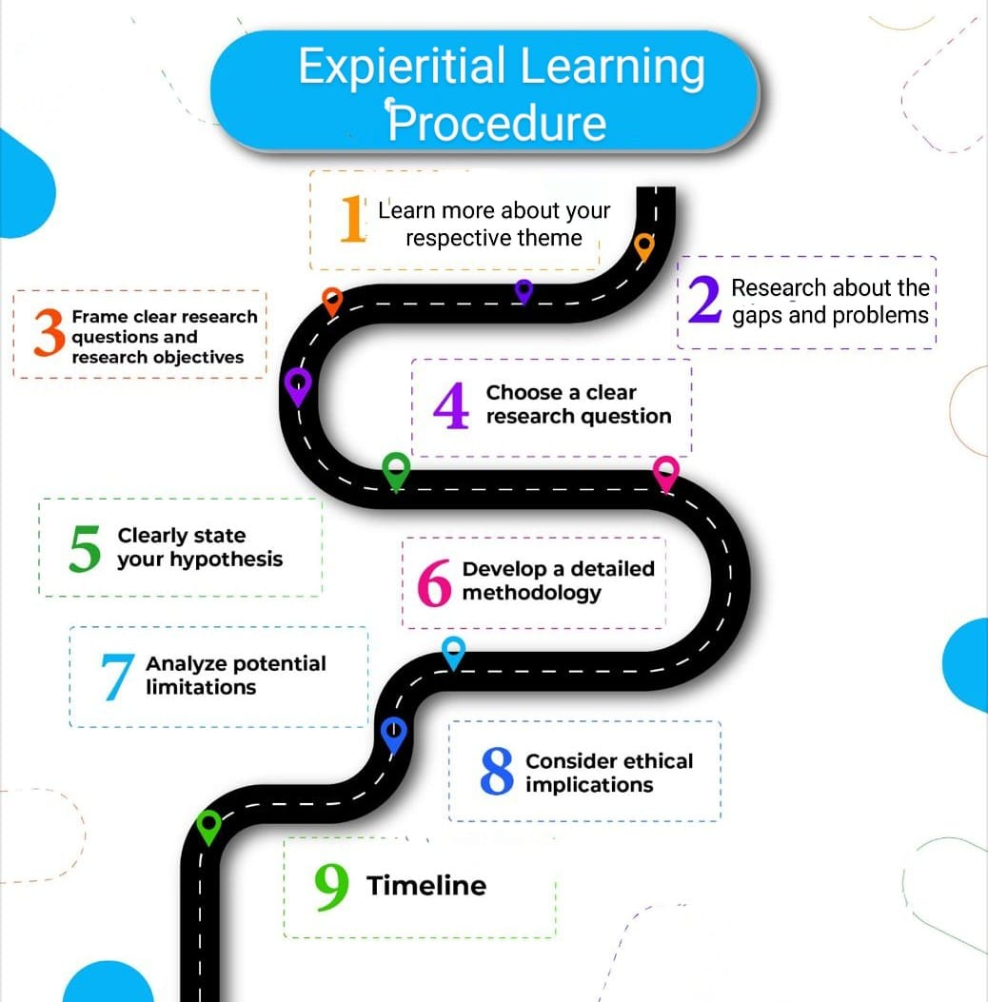
26 April 2025

Slide 4
EL Phase-I
Presentation Outline
Introduction
Literature Review
Problem Definition
Objectives
Methodology
Proposed Outcomes
Timeline of the project
Conclusion
References
26 April 2025

Slide 5
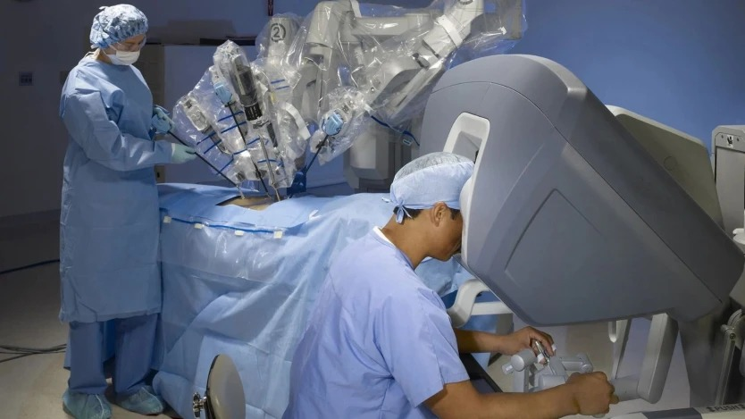
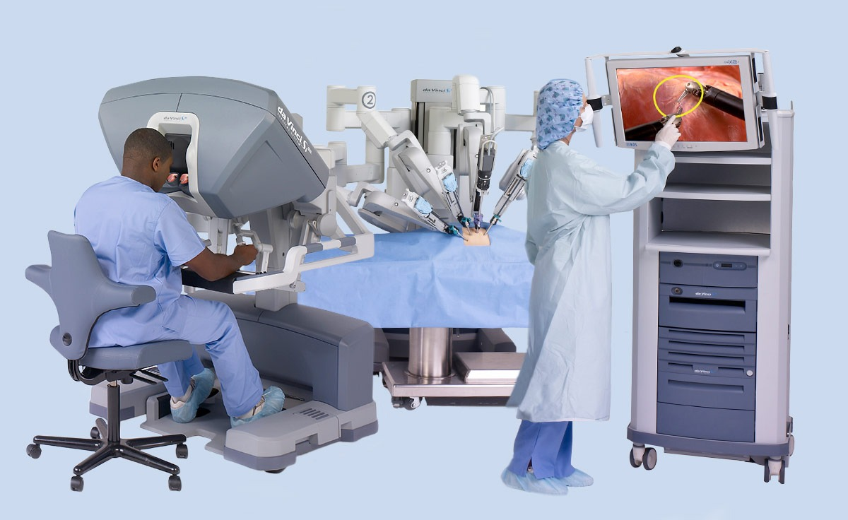
Da-Vinci Surgery

Slide 6
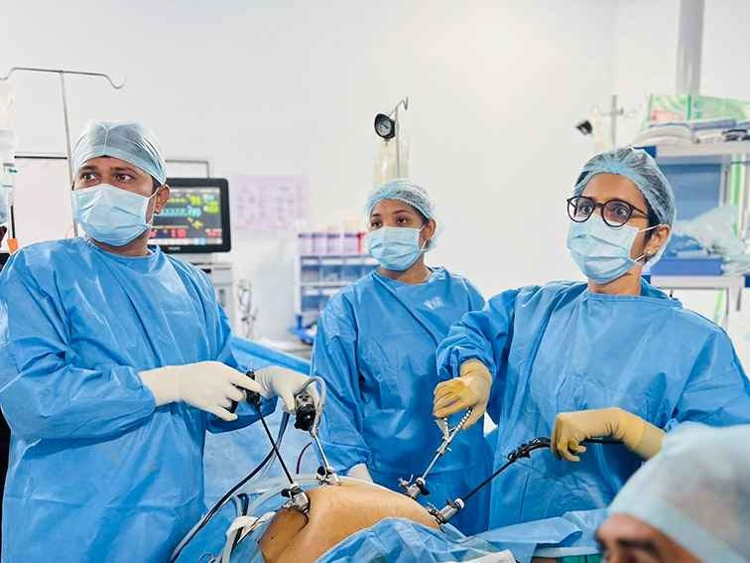
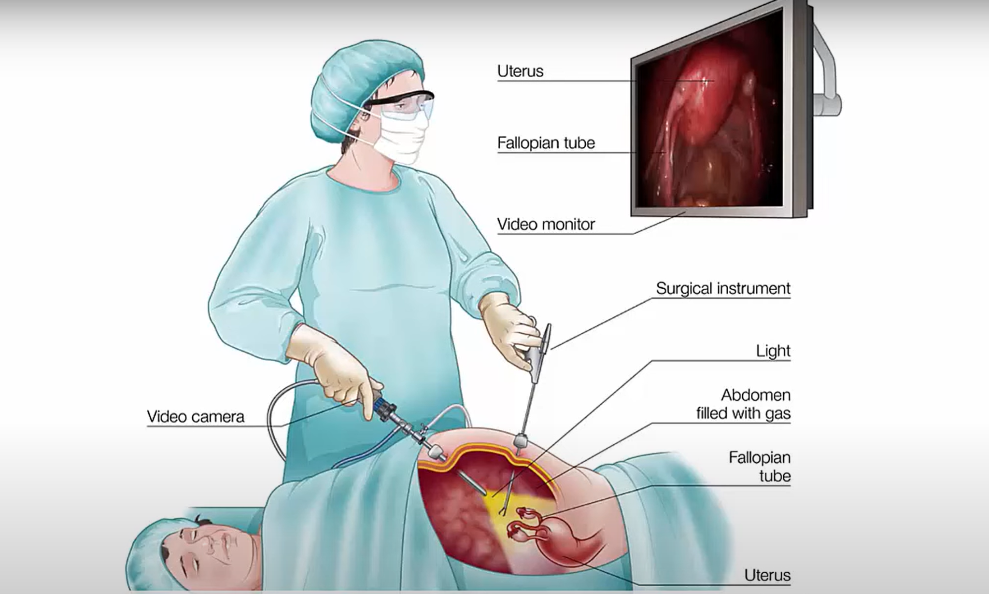
Laparoscopic Surgery

Slide 7
Introduction
Overview of the topic: The arm will be designed in SolidWorks and 3D printed for customizability. Servo motors, Arduino or esp32 will be used to control its movements, ensuring precise handling of laparoscopic equipment. The arm aims to reduce the need for human assistance, minimize fatigue, and enhance stability during surgery, improving both safety and surgical outcomes. Challenges include designing for precision, ensuring sterility, and developing real-time control systems.
Importance of the topic: The robotic arm for laparoscopic surgery is important because it enhances surgical precision, reduces the need for human assistants, and minimizes surgeon fatigue. It improves the stability of instruments, leading to safer and more accurate procedures. By automating support tasks, it helps streamline operations, shortens surgery time, and can improve patient recovery and outcomes.
26 April 2025
Slide No. ‹#›

Slide 8
Literature Review
Sl No. | Year | Title | Author | Method | Key findings | Limitations
1 | 2025 | Development of a Wifi enabled Robotic arm with real time web based control | Sevara, A. J., Bamania, P. R., Bhatt, H. M., & Lakhwani, M. A. | ESP-32 microcontroller connects to a web-based GUI over Wi-Fi.User inputs on the GUI are sent in real-time to the ESP-32.ESP-32 controls six servo motors to move the robotic arm (6-DOF). Positioning and response are tuned to achieve high accuracy and fast reaction. | This paper presents the design and development of robotic arm using servomotors and esp-32 microcontroller.A web-based interface allows users to control the arm in real-time. | Limited payload, Wi-Fi dependence, 2 mm precision not for ultra-fine tasks.
2 | 2022 | Analysis and Simulation of Mechanical Arm Dynamics Model Based on Simulink | D. Zhang, W. Ma and H. Zhang, | Used LabVIEW, MATLAB, ADAMS, and RoboDK for simulation and applied PID control for motor optimization. | This paper focuses mainly on using various simulation softwares and comparing their results. | A good number of software tools are paid, which results in elimination of usage of fewer tools.
26 April 2025

Slide 9
Literature Review
3 | 2020 | Design and Development of IoT-based Robot | Trisha, & Kumar, S. D. | Designed an Arduino-based robotic arm with Bluetooth IoT control via a mobile app. | The use of IOT resulted in introduction of time delay of nearly 400-600m,also external power was used to power all 5-6 motors. | Time delay or lag was introduced as a result of usage of IOT. The power supply requirements was not met by arduino, in order to overcome this issue, external power supply was used.
4 | 2017 | Robotic Arm Control through Mimicking of Miniature Robotic arm | Megalingam, R. K., Boddupalli, S., & Apuroop, K. G. S | Potentiometers measure joint angles, Arduino maps and transmits data via Bluetooth to control servos. | Miniature robotic arm with potentiometers wirelessly controls a robotic arm in real-time with high accuracy using Arduino,Bluetooth | Bluetooth range limits control distance; analog readings may introduce minor noise/errors.
26 April 2025

Slide 10
Literature Review
5 | 2015 | A preliminary study on joint to joint control master device for single port laparoscopic surgery robot | Shim, S. Kang, T. Ji, D. Hong, J. | Introduced individually motorized joints for direct control in surgical robots. | Achieved easier, safer, and more flexible operation compared to gear-based systems. | More motors can increase circuit complexity(as on increasing motors would result in power requirements), size, and cost.
6 | 1996 | A Remote Center of Motion Robotic Arm for Computer Assisted Surgery | Eldridge, B., Gruben K., LaRose, D. Funda, J., Gomory, S. Karidis, J. McVicker G Taylor R Anderson, J | Integrated a 6-DOF force-torque sensor with force-guiding control to create a pseudo-back-drivable robotic arm. | Enabled smoother, coordinated robot responses in Cartesian space, improving handling. | Software-driven back-drivability may introduce slight lag or complexity compared to fully passive systems.
26 April 2025

Slide 11
Problem Definition
Clear statement of the problem: The problem being addressed is the lack of stability and precision in manual laparoscopic surgery, which often requires an assistant to hold and adjust the laparoscope. Human fatigue and inconsistent positioning can lead to increased surgery time, and potential surgical errors. A robotic arm that autonomously holds and stabilizes laparoscopic instruments can improve precision, reduce reliance on assistants, and enhance surgical outcomes.
Context of the Problem: Laparoscopic (minimally invasive) surgery relies on small incisions and long, slender instruments, including a laparoscope (camera) for internal visualization. Currently:The laparoscope is often manually held by a surgical assistant, leading to hand fatigue, shaky images, and misalignment.Robotic systems like the da Vinci Surgical System exist but are expensive, bulky, and require specialized training.Many hospitals (especially in low-resource settings) cannot afford advanced robotic assistance, leading to continued dependence on human assistants.A low-cost, 3D-printed robotic arm with servo motors could provide a compact, customizable, and affordable alternative, improving stability without the complexity of high-end systems.
26 April 2025

Slide 12
Significance of Addressing the Problem
Increased Surgical Risk: Human-held laparoscopes can cause unstable visuals, leading to errors in delicate procedures.
Surgeon Fatigue & Workflow Disruptions: Dependence on assistants slows down procedures and increases coordination challenges.
Limited Access to Robotic Assistance: High costs of existing robotic systems prevent widespread adoption, leaving many hospitals without stabilization solutions.
Higher Healthcare Costs: Longer surgery times and potential complications increase expenses for patients and hospitals.

Slide 13
Objectives
Main Objective: To design, build, and control a 3D-printed robotic arm using motors to securely hold laparoscopic instruments, improving surgical stability and reducing the need for human assistance.
Specific Objectives:
Design a lightweight robotic arm in SolidWorks suitable for laparoscopic surgery.
3D print the arm.
Integrate servo motors for precise and stable movement of laparoscopic instruments.
Develop a simple control system for real-time adjustments during surgery.
26 April 2025

Slide 14
Expected Contributions to the Field: This project aims to enhance the stability and precision of laparoscopic surgeries, reduce the physical burden on surgical teams, and pave the way for affordable, customizable robotic support systems in operating rooms.

Slide 15
Methodology
Design: We will follow a qualitative approach, which means our focus will be on understanding and meeting the real needs of surgeons during laparoscopic surgery.
Instead of working only with numbers and formulas, we will design, build, and test the robotic arm based on important factors like how steady the arm holds the instruments, how easy it is to control the movements using buttons, and how accurately the arm positions the tools.
Throughout the process, we will make improvements by observing how the robotic arm performs in each particular joint and also the end effector.
26 April 2025

Slide 16
Data Collectinon Methods:
Literature Review: Existing research studies on robotic arms in surgery to understand challenges and trends.(source: Research Papers, Youtube videos,Blogs etc)
Simulated Testing: Test your robotic arm in a virtual or controlled environment for performance data.(softwares used:SolidWorks,Robo DK etc)
Prototype Testing: Test the 3D printed arm in real-world scenarios to gather data on precision and stability.
Observational Studies: Observe existing robotic systems to note their effectiveness and limitations.(softwares used:MATLAB Simulink)

Slide 17
Data Analysis Techniques:
Statistical Analysis: Analyze survey and experiment data for patterns and trends.(software tools:Robo DK)
Performance Analysis: Evaluate the arm's effectiveness based on task completion and feedback.(software:MATLAB Simulink)
Comparative Analysis: Compare the performance of the 3D printed robotic arm with assembled arm in various software platforms to identify areas of improvements.
Failure Mode Analysis: Analyze potential failure points during testing to understand risks and areas where the design needs reinforcement.(Compare results/data from softwares and 3D printed model to identify areas of potential failures)

Slide 18
Tools and Resources Used:
Mechanical Tools for simulation:
CAD Software (like SolidWorks,Solid EDGE) – for designing the robotic arm.
3D Printer – to print parts individually
Blender
Labview
Matlab simulink
RoboDK
Mechanical Tools (Hardware):
Bolts: standard M3, M4, M5 dimensional parts.
Nuts: Lock nuts and wing nuts.
Washers: Flat and lock washers.
Screws: Self-tapping for plastic/metal.
Tools: Wrenches and screwdrivers.
Electronics and Hardware:
Microcontroller (Esp32) – to control the robotic arm.
Servo Motors or Stepper Motors – for smooth and precise movement.
Power Supply – to provide stable power to motors and controller.
Potentiometer-to manually move the robotic arm by adjusting the value of potentiometers for each motor.

Slide 19
Control Interface:
Push Buttons: For manually controlling the robotic arm's movement with the help of potentiometers (e.g., up, down, left, right).
Wires & Connectors:
Jump Wires: For connecting the servo motors, sensors, and microcontroller.
Software:
Arduino IDE: For programming the microcontroller to control the robotic arm.
Wokwi: To simulate and test the circuit design virtually before building.

Slide 20
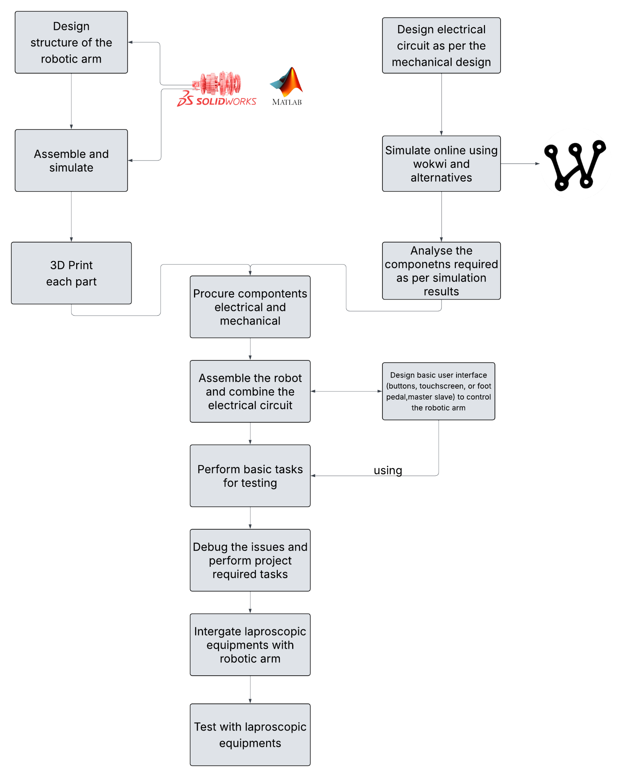
Methodology
26 April 2025

Slide 21
Proposed Outcomes
Expected Results: We expect to create a fully functional 3D-printed robotic arm capable of securely holding and adjusting laparoscopic instruments with high precision and stability, reducing the need for a human assistant during surgery.The arm will be easy to control and will provide smooth, steady movements, helping surgeons focus better on critical tasks.
Potential Impact on the Field: The project could lead to more efficient and stable laparoscopic surgeries, lower operating room staffing needs, and inspire the development of affordable robotic aids for minimally invasive procedures, especially in smaller hospitals and clinics.
26 April 2025

Slide 22
Future Research Directions: This work could lead to future studies on adding AI-based automation, where the robotic arm can automatically adjust the tools during surgery without needing constant manual control. Researchers could also focus on adding force-feedback sensors, so the arm can "feel" how much pressure it is applying and handle instruments more safely. Another direction could be designing parts of the robotic arm that are either easy to sterilize or made for one-time use, making them safer and more practical for hospitals.

Slide 23
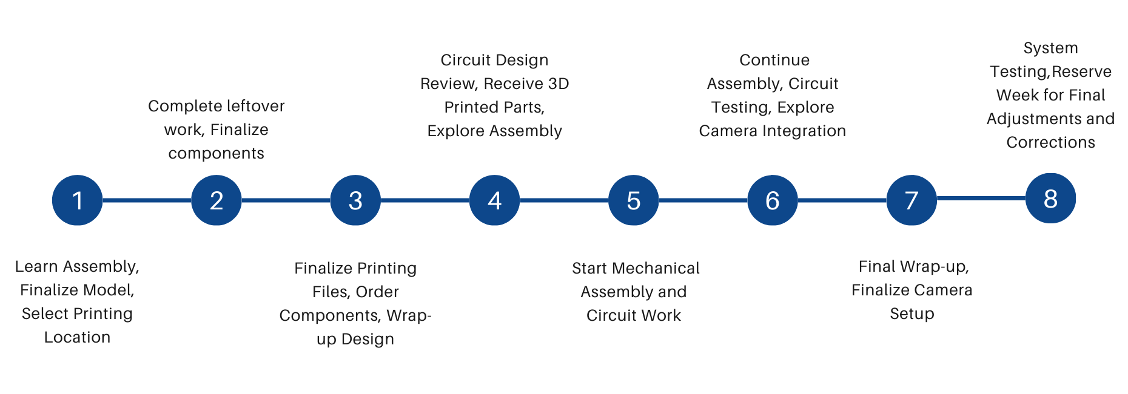
Timeline of the project
26 April 2025

Slide 24
Conclusion
Summary of Key Points:
Problem: Manual laparoscopic surgery suffers from instability due to human-held instruments, leading to fatigue, shaky visuals, and reliance on assistants.
Solution: A 3D-printed robotic arm (designed in CAD Software) with servo motors to autonomously hold and stabilize laparoscopic tools, improving precision and reducing assistant dependency.
Significance: Offers a low-cost, accessible alternative to expensive robotic systems, enhancing surgical accuracy and workflow efficiency.
Final Thoughts:
This project bridges a critical gap in minimally invasive surgery by providing an affordable, customizable, and stable robotic assistive tool.
By leveraging 3D printing and servo motor control, it democratizes access to robotic assistance, benefiting surgeons in both high- and low-resource settings.
26 April 2025
Notes:
‹#›

Slide 25
Call to Action or Next Steps:
Finalize Design: Optimize the SolidWorks model for 3D printing (material strength, joint flexibility).
Prototype & Test: Assemble the arm, integrate servos, and validate stability with laparoscopic tools.
Control System: Develop a user-friendly interface (e.g., joystick, voice commands, or foot pedals) for surgeon control.
Clinical Feedback: Collaborate with surgeons for real-world testing and iterative improvements.
Future Scaling: Explore motor upgrades, AI-assisted tracking, or haptic feedback for advanced functionality.

Slide 26
References
List of References:
https://www.ijfmr.com/papers/2025/2/41391.pdf
https://ieeexplore-ieee-org-vtuconsortia.knimbus.com/document/10087600
https://ieeexplore-ieee-org-vtuconsortia.knimbus.com/document/9154175
https://ieeexplore.ieee.org/document/8014622
https://ieeexplore-ieee-org-vtuconsortia.knimbus.com/document/7358953
https://www.cambridge.org/core/journals/robotica/article/remote-center-of-motion-robotic-arm-for-computer-assisted-surgery/D597E98B066508B28AF12BA8F6DC78BB
Citations in Appropriate Format:
Sevara, A. J., Bamania, P. R., Bhatt, H. M., & Lakhwani, M. A. (2025). Development of a Wi-Fi enabled robotic arm with real-time web-based control. International Journal for Multidisciplinary Research (IJFMR)
D. Zhang, W. Ma and H. Zhang, "Analysis and Simulation of Mechanical Arm Dynamics Model Based on Simulink," 2022 2nd International Conference on Algorithms, High Performance Computing and Artificial Intelligence (AHPCAI), Guangzhou, China, 2022,
Trisha, & Kumar, S. D. (2020). Design and development of IoT-based robot. In 2020 International Conference for Emerging Technology (INCET) (pp. 1–4). IEEE.
Megalingam, R. K., Boddupalli, S., & Apuroop, K. G. S. (2017, January). Robotic arm control through mimicking of miniature robotic arm. In 2017 4th International Conference on Advanced Computing and Communication Systems (ICACCS) (pp. 1-7). IEEE.
Shim, S., Kang, T., Ji, D., & Hong, J. (2015). A preliminary study on joint to joint control master device for single port laparoscopic surgery robot. In Proceedings of the 12th International Conference on Ubiquitous Robots and Ambient Intelligence (URAI) (pp. 281–283).
Eldridge, B., Gruben, K., LaRose, D., Funda, J., Gomory, S., Karidis, J., ... & Anderson, J. (1996). A remote center of motion robotic arm for computer assisted surgery. Robotica, 14(1), 103-109.
26 April 2025
Notes:
‹#›

Slide 27
Expected Outcome by the end of First Year
EL should aim for tangible results in one of the following forms:
Patent Filing: If your prototype shows novel functionality or an innovative process, file for a patent. Steps include drafting a patent description, claims, and conducting a prior art search.
Journal Publication: Write a comprehensive paper detailing the methodology, prototype design, testing, and results. Submit to journals related to manufacturing technology, engineering design, or industrial innovation.
Conference Publication: Prepare an abstract or full paper for submission to conferences. Present your prototype development, key findings, and future research possibilities (Paper to be drafted as per IEEE format. Format will be shared later on)
Research Proposal: Propose extending the research into a larger project, securing funding for mass production, or applying the process to different industries. Include objectives, proposed methodology, expected impacts, and a budget estimate.
26 April 2025
Notes:
‹#›

Slide 28

26 April 2025

